Slide 1

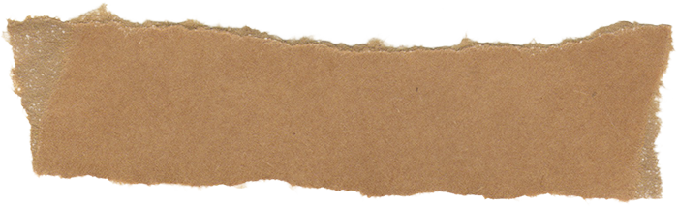
Web
Development
Project

Slide 2
Our Team
Aryan Khunt
Raj Patel
Dev Joshi
Parth Shah
Nikhil Desai

Slide 3
Introduction
Web development involves building websites and applications using technologies like HTML, CSS, and JavaScript. It is split into frontend (user interface) and backend (server-side logic). This project explores web tech stacks, modern frameworks, and full-stack development trends. It also covers responsive design, accessibility, and performance optimization in real-world scenarios.

Slide 4

Project Overview
Our project dives into how websites are designed, developed, and deployed using modern tools and best practices.

Slide 5
Objectives
To learn about core web technologies
To build a responsive web app

Slide 6
Methodology
Team Meetings
Module Assignments
Each member handled frontend or backend tasks
We used Git for version control and VS Code for development

Slide 7
Process
Planning
Designing
Coding
We planned the structure of our site
Designed using Figma and CSS frameworks
Implemented using React and Node.js

Slide 8


Analysis
The development process revealed how component-based design improves reusability and scalability in modern apps.

Slide 9
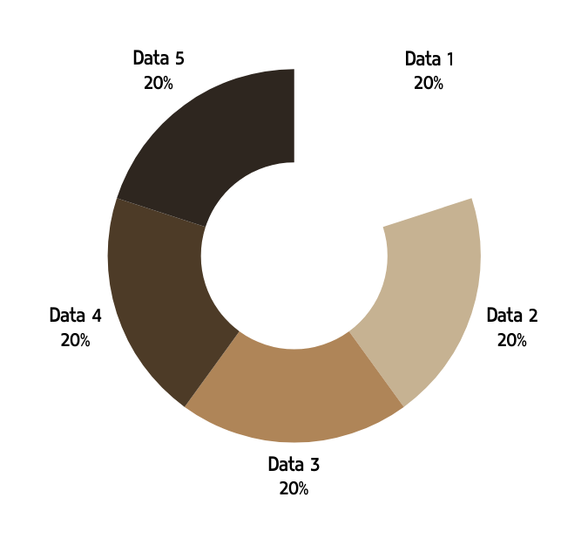
Data
We tracked commit history
Monitored page speed metrics

Slide 10
Conclusion
Web dev teaches problem-solving and design
Teamwork improved our efficiency

Slide 11



Documentation

Slide 12
Recommendation
Learn DevOps and CI/CD pipelines
Try building with Next.js and Tailwind CSS

Slide 13
Thank You

